Slide 1
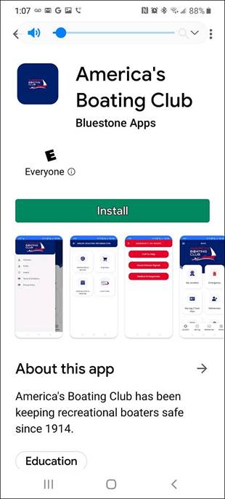
Find the download webpage at americasboatingclub/app and click on the Google or Apple link depending on your phone type
or
Search for
“America’s Boating Club”
on Google Play, or Apple Store
and you’ll see this:
Click Install

Slide 2
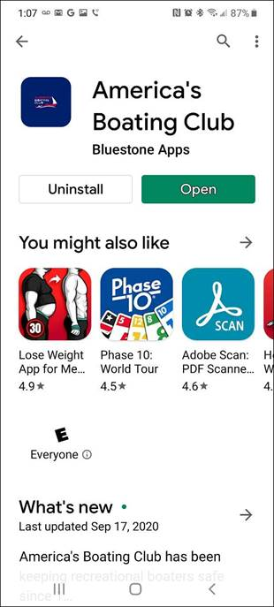
Select “Install,”
and you will see this:
Click Open

Slide 3
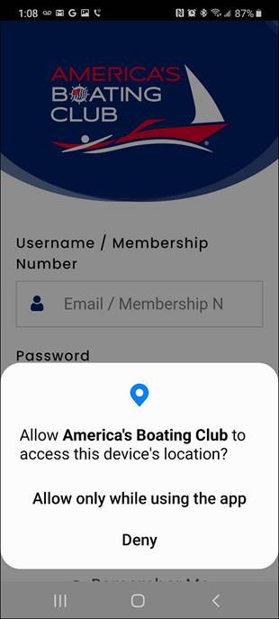
Select “Open,”
and you’ll see this:
Select Allow

Slide 4
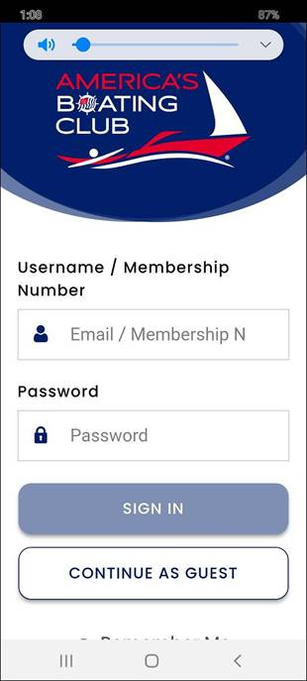
Select “Allow…,”
and you’ll see this:
Hold it…….scroll down to bottom of page
You must create an account before the app will let you sign in!

Slide 5
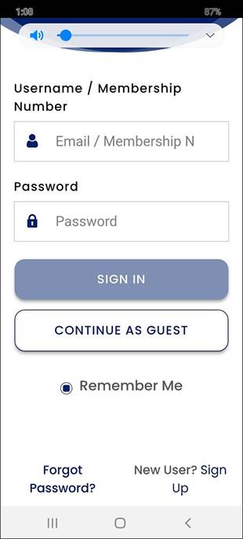
Scroll down to
the bottom of the screen,
and you’ll see this:
Click “New User? Sign Up”

Slide 6
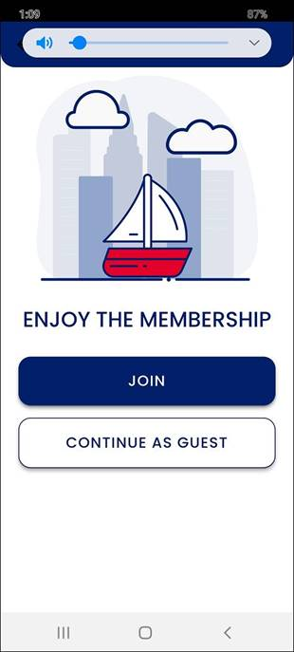
Select
“New User? Sign up,”
and you’ll see this:
Click Join

Slide 7
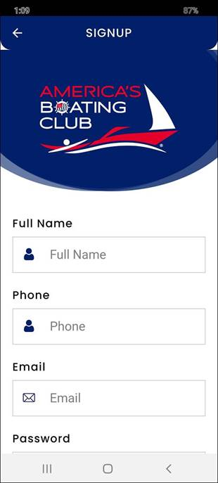
Select “Join,”
and you’ll get this screen:
Create an account by filling in the information fields including email and password

Slide 8
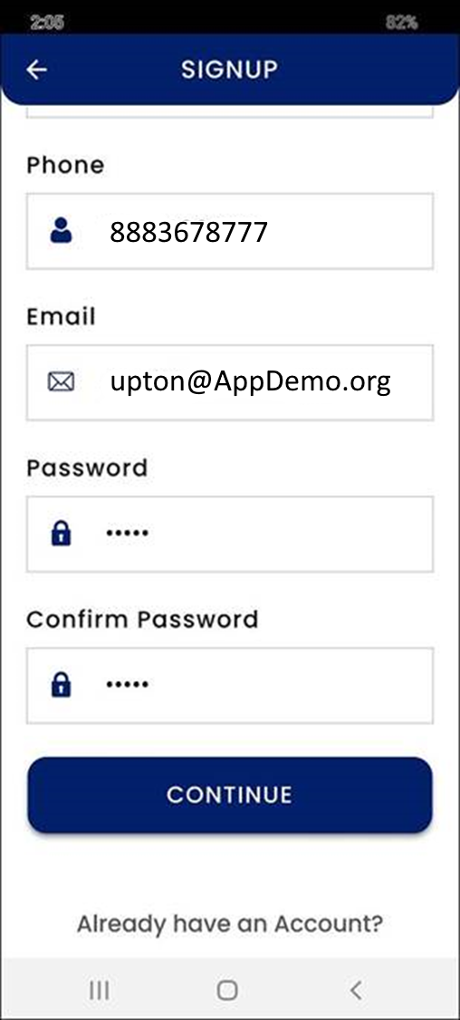
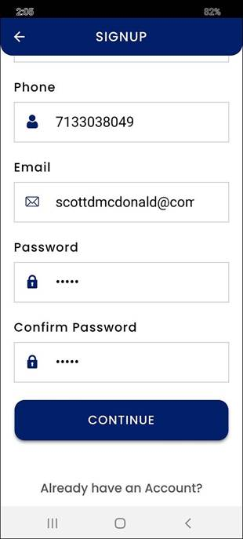
Scroll down to complete the form.
NOTE: The password field indicated,
“Password must be 5.”
(It doesn’t say minimum, maximum, just 5)
If you have trouble processing the enrollment, make sure your password is at least 5 characters.

Slide 9
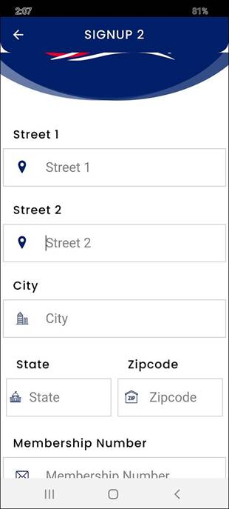
After selecting “Continue,”
the application brings up
the signup screen
to provide other information.
This includes your membership
number and renewal date.
If you can’t remember your renewal date, guess! You can always edit your profile later.
Note: The member number and renewal date are not required fields.

Slide 10
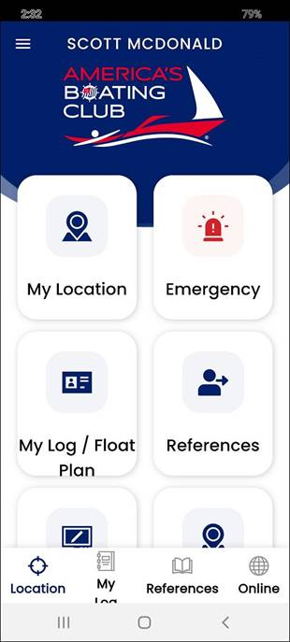
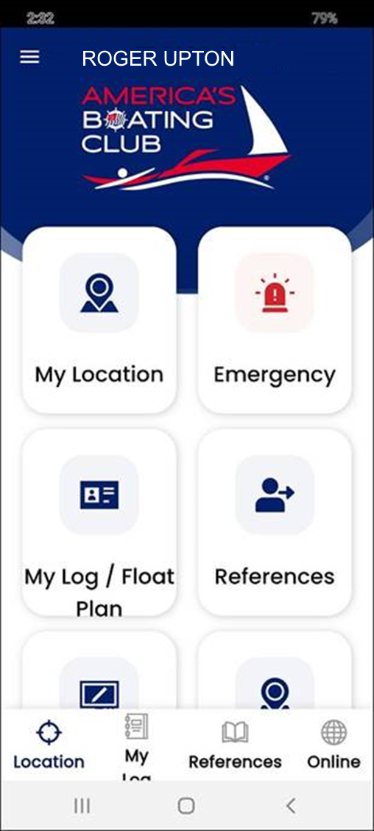
Once the account information
is completed, the application
will bring you to the main screen:
Congratulations!
You have successfully created your account.
Enjoy!

